Slide 1
Goa Tourism Website

Slide 2
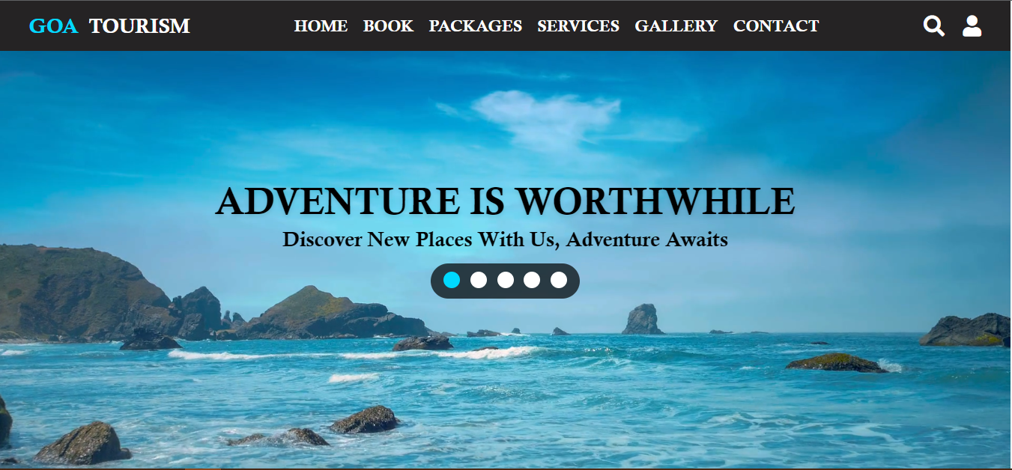
Front Page

Slide 3
Motivation
We have build this website to provide information regarding the famous places in Goa and displayed relevant information about it.We have try to solve the difficulty which a person face while travelling in a new destination.

Slide 4
Services Provide by Our Website

Slide 5
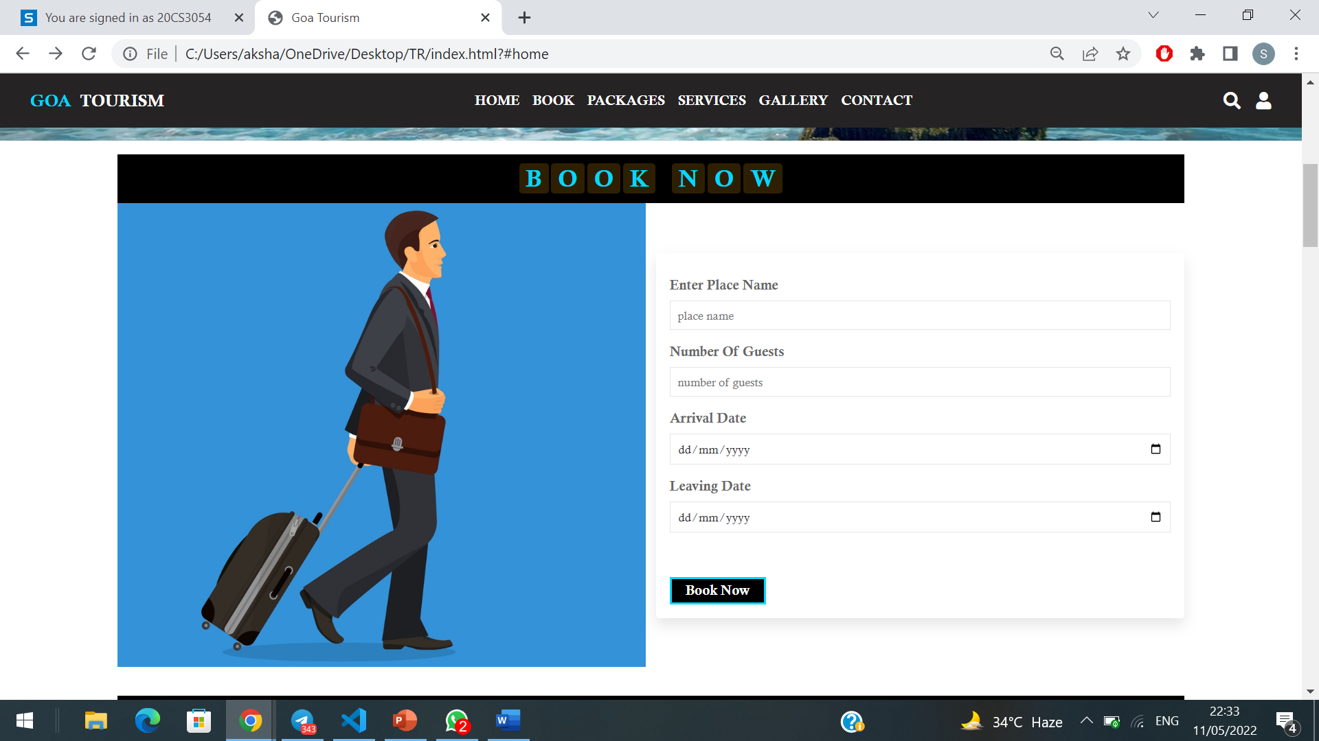
User can plan a trip

Slide 6
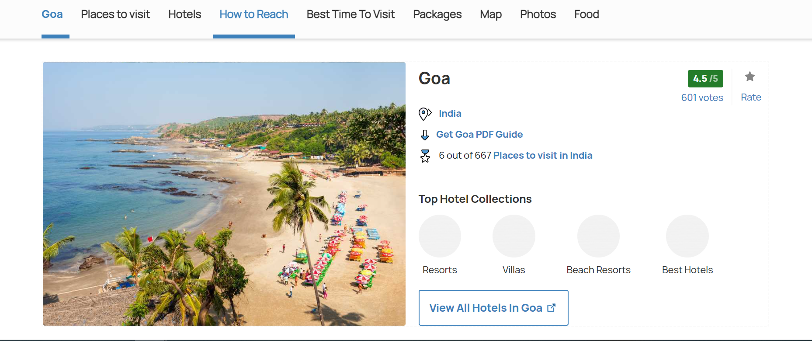
Provide relevant information about Goa

Slide 7
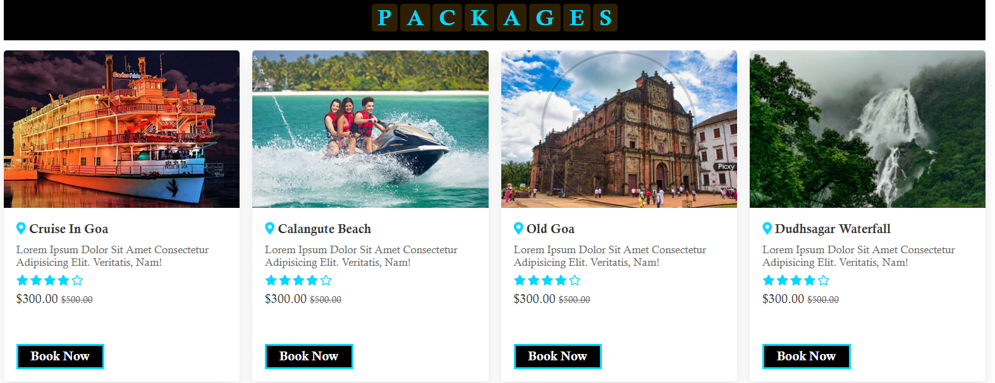
Search for packages in Goa

Slide 8
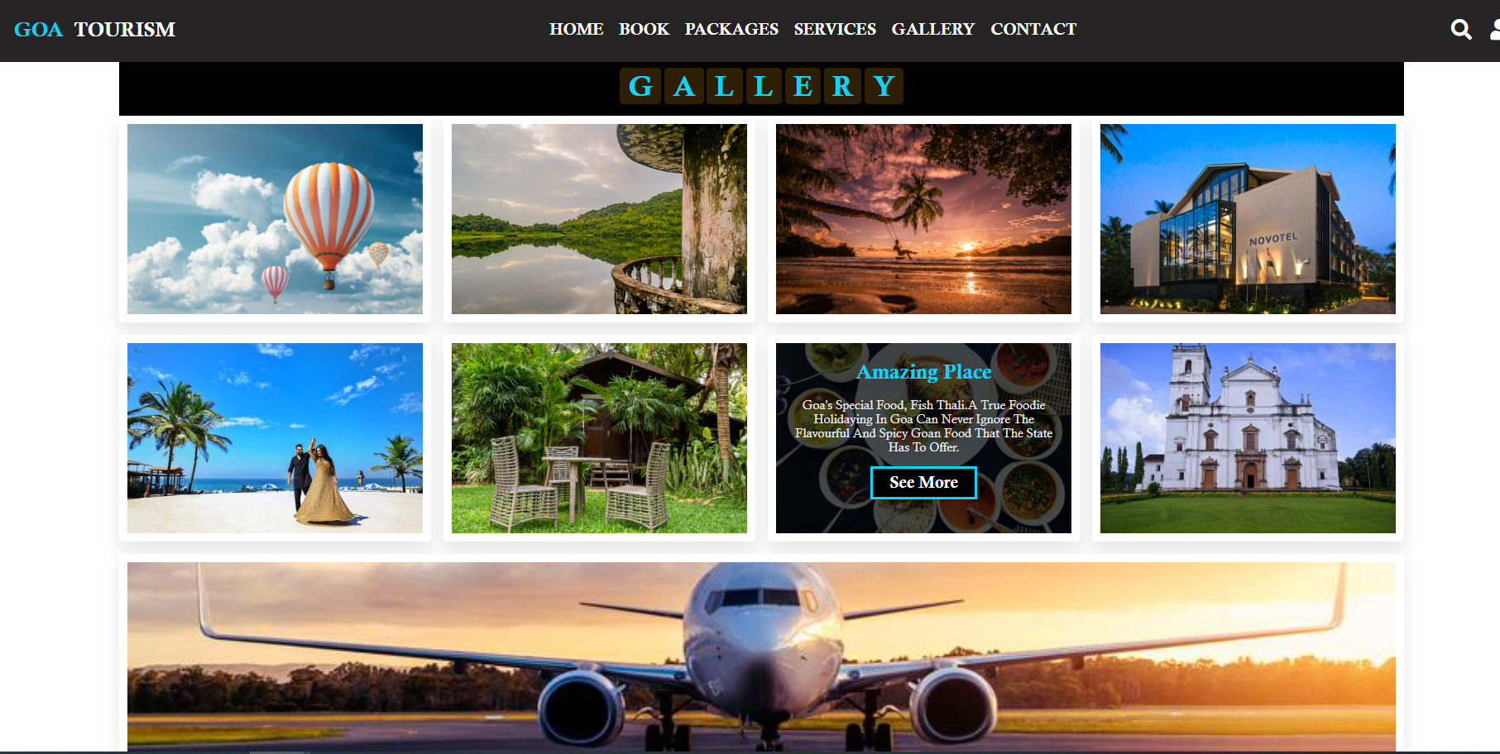
Given a gallery section which consist of famous places and activities of Goa as well as famous resorts.

Slide 9
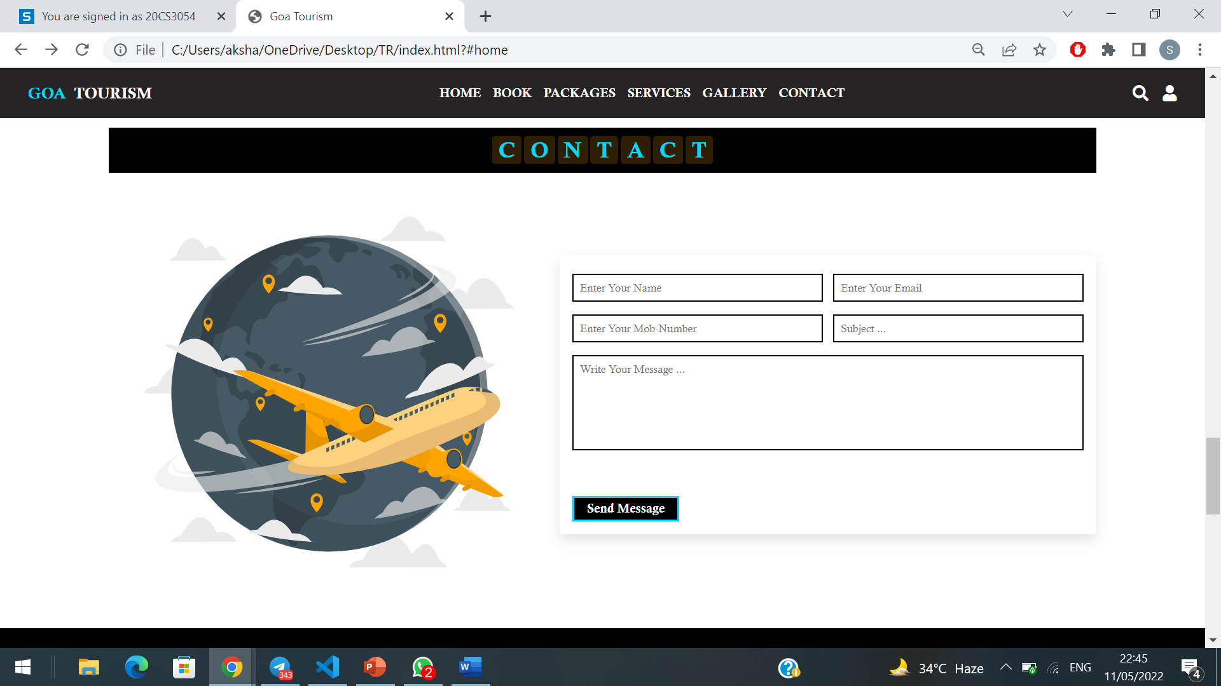
Registration Page

Slide 10
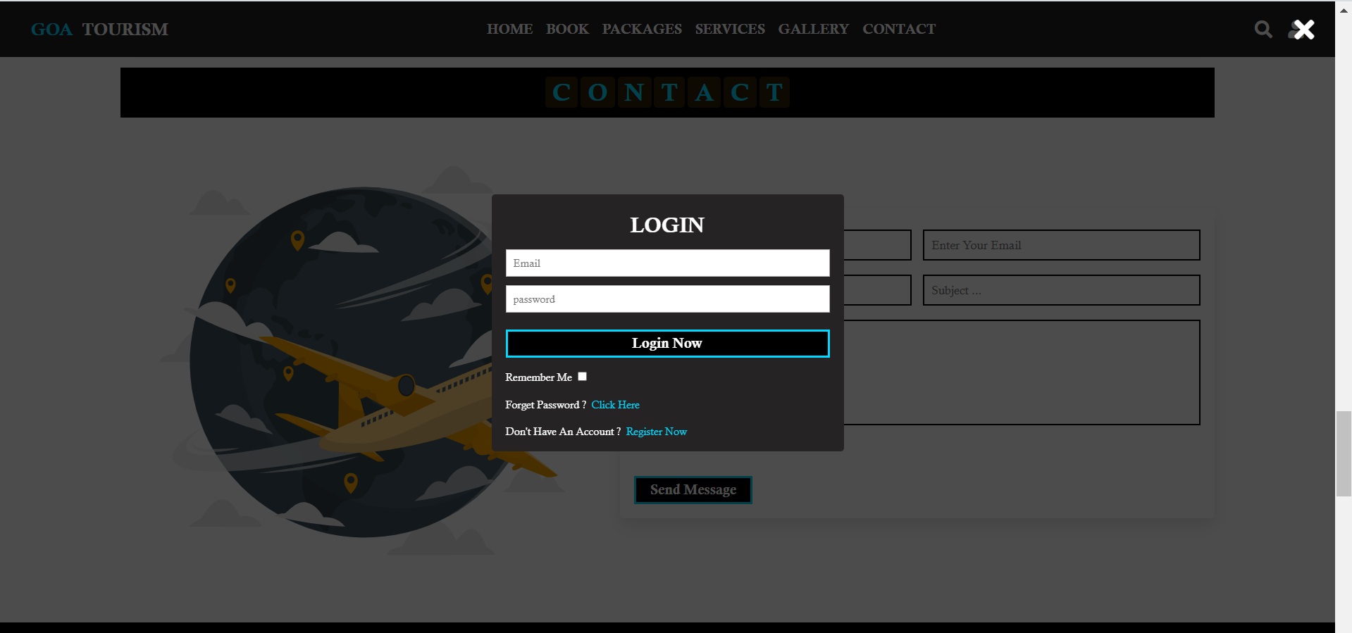
Login Page

Slide 11
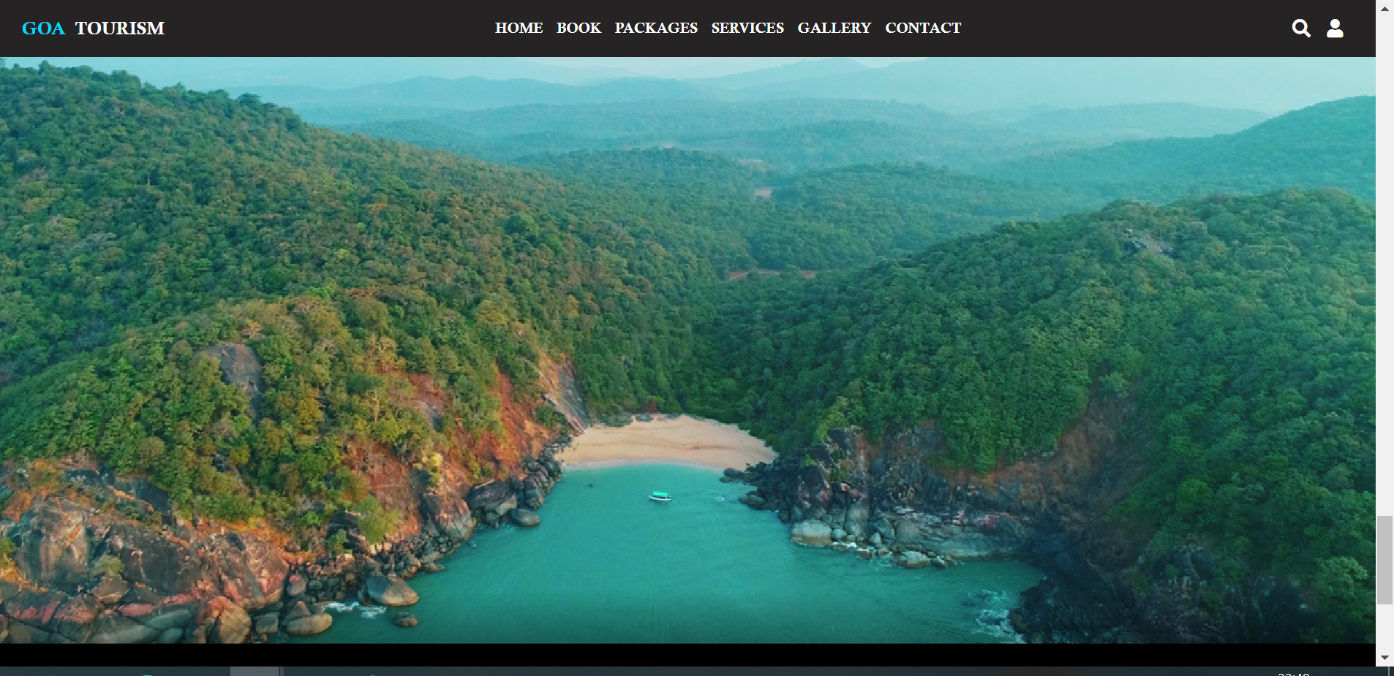
Video Package of Goa

Slide 12
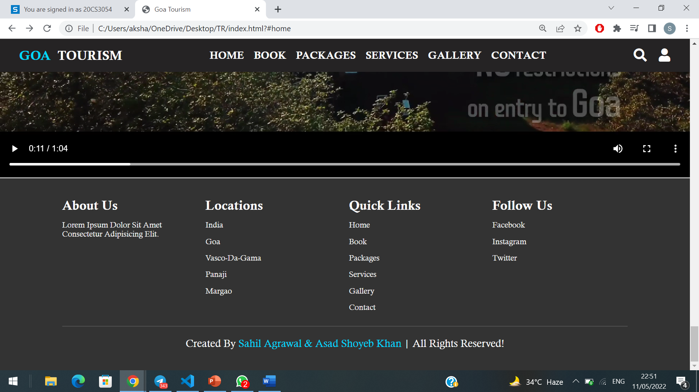
Footer

Slide 13
Languages Used
HTML
CSS
Advanced JavaScript

Slide 14
Future Aspiration
Add more destination
Provide a services where users can see nearby hotels
and select them based on their budget
Add Flight and train information from current location to chosen destination .
Website also calculate cost per trip per person for group of people.

Slide 15
BY -
Asad Shoyeb Khan – 20CS3012
Sahil Agrawal – 20CS3054

